Slide 1
Exploratory data analysis
In our Face Detection Model

Slide 2
Getting the images
The main data used in our project is the images containing the faces of the attendees .
The faces are loaded into the program using pillow library.
The images are greyed , because we don’t need color data.

Slide 3
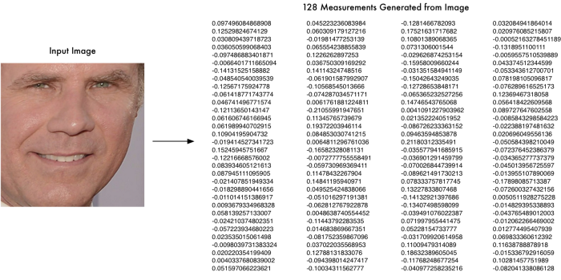

Slide 4
Recognition Algorithm
The images are sent to the training phase and saved in the respective directory of the named folder.
Then get the HOG pattern on the faces and store the encodings.
The encodings consists of 128 unique measurements for each face, which is used to compare with the face on webcam later in the project.

Slide 5
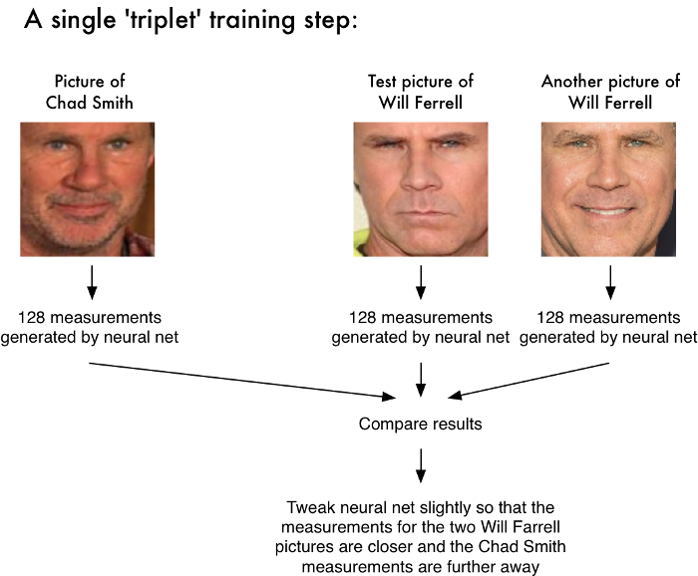

Slide 6
recognition
Finding the Face:
Locating the face in the frame by haar-cascading classifier and identify its position (Height , Width).
Recognise the face by comparing the part of the image to a known HOG pattern that is given in training phase.

Slide 7
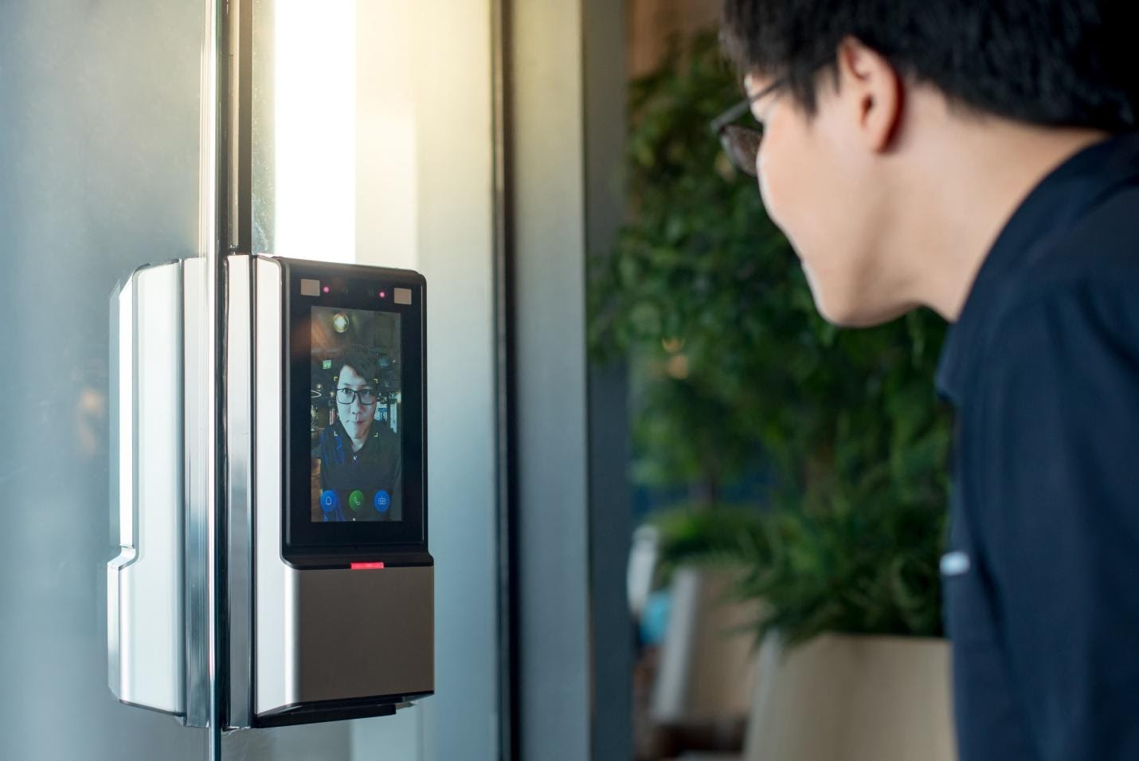

Slide 8
Matching
After comparing the encoding , the person will be detected and the attendance will be given to him automatically.

Slide 9
reference
https://medium.com/@ageitgey/machine-learning-is-fun-part-4-
modern-face-recognition-with-deep-learning-c3cffc121d78

Slide 10


